Slide 1



G H RAISONI COLLEGE OF ENGINEERING AND MANAGEMENT
(Approved by AICTE, New Delhi and Recognized by DTE, Maharashtra)
An Autonomous Institute Affiliated to Rashtrasant Tukadoji Maharaj Nagpur University, Nagpur
Accredited by NAAC with A+ Grade
Department of Computer Science and Engineering
Project Quality Assurance Initiative 2025-26
On
An AI-Based Flood Risk Early Warning System
Guide:
Antara Bhattacharya
Assistant Professor
Name of Projectees
Adil Khan Alfiyanaj Qureshi Akash Keote
Amey Bhiogade Anshika Arya
Session 2025-2026

Slide 2
Contents
Introduction
Literature Survey
Problem Statement
Objective of Project
Methodology
Implementation
Work done
Innovative work (If any)
Results & Discussion
Conclusion & Future Scope
Publication / Presentation / Project Competition
Project Cost Estimation
References

Slide 3
Introduction
Mumbai faces severe flooding almost every monsoon, causing loss of life, property damage, and economic setbacks.
The city’s outdated drainage system is unable to handle today’s intense monsoon rainfall.
Current flood management is reactive, relying on static maps and post-disaster relief.
There is a critical need for an integrated system combining prediction, mapping, evacuation routing, and automated alerts to improve flood resilience.
Here, our project tackles this important problem by creating an AI-powered predictive early warning system.
This system aims to give timely and precise flood risk alerts.
It can help lessen the disaster's impact and improve emergency planning and response.

Slide 4
Literature Survey
Sr. No. | Paper Title and its Author | Details of Publication | Findings
1 | Flood Prediction Using AI – Western Maharashtra Case Study Mayuresh A. Patil, Dr. Anil R. Surve | Conference Paper, Feb 2025 Walchand College of Engineering, Sangli | Advantage: Uses real-time hydrological data for localized prediction. Limitation: Accuracy not quantified. Method: LSTM, CNN, real-time sensors.
2 | GeoNet – Deep Learning for Flood Likelihood Monitoring Ms. Anjali P. Kadam, Dr. Prakash Devale | International Journal of Intelligent System And Application In Engineering, Vol. 12(23s), 2024 BVDU COE, Pune | Advantage: High-performing deep learning model. Limitation: Based on only 1-year data from Kolhapur. Method: GeoNet (custom DL), RNN. Accuracy: 85%

Slide 5
Literature Survey
Sr. No. | Paper Title and its Author | Details of Publication | Findings
3 | Flood hazard analysis in Mumbai using geospatial and multi-criteria decision-making techniques Yash Parshottambhai Solanki, Vijendra Kumar, Kul Vaibhav Sharma, Arpan Deshmukh and Deepak Kumar Tiwari | Journal of Water and Climate Change Vol 15 No 5, 2024 | Advantage: GIS-based flood susceptibility mapping using real parameters. Limitation: Uses Static data, lacks live input. Method: AHP + GIS (ArcGIS layers: NDVI, slope, etc.).
4 | Remote Sensing and GIS Assessment of Flood Zones: A Case Study of the Bhima River Basin Mahesh. S. Waghmare , Shrishail. S. Shahapure | International Journal of Intelligent System And Application In Engineering Vol. 7, Article 3627, 2023 | Advantage: Good regional flood susceptibility analysis. Limitation: Static risk map, not a predictive model. Method: Weighted overlay in ArcGIS.

Slide 6
Literature Survey
Sr. No. | Paper Title and its Author | Details of Publication | Findings
5 | Assessing Of Flood Disaster Impact on Agriculture in Western Maharashtra Rivers Dr. Amol M. Pawar | International Journal of Advance and Applied Research, Vol.5 No.8, Mar–Apr 2024 Sangola Mahavidyalaya | Advantage: Detailed GIS + remote sensing (RS) assessment of flood impact on agriculture and soil degradation in Satara district. Limitation: No ML or AI-based flood prediction model; lacks real-time forecasting. Method: GIS, RS, GPS-based mapping, LULC analysis.

Slide 7
Literature Survey
Sr. No. | Paper Title and its Author | Details of Publication | Findings
6 | The Maharashtra River Basin’s Flood–Drought–Water Scarcity Nexus Manisha Shinde-Pawar et al. | Global NEST Journal, Vol. 26 No. 5, 2024 Rajarambapu Institute of Technology & Bharati Vidyapeeth University | Advantage: In-depth analysis of water resilience, climate vulnerability, and urban planning in Maharashtra. Limitation: No direct prediction model or AI algorithm implemented. Method: Policy review, stakeholder analysis, historical climate data, scenario modeling.

Slide 8
Literature Survey
Sr. No. | Paper Title and its Author | Details of Publication | Findings
7 | Flood Susceptibility Accuracy Assessment of Panchganga River Basin (PRB), Kolhapur, Maharashtra (India) using Frequency Ratio and Weight of Evidence Model Prashant N. Pusdekar, Sanjay V. Dudul | International Journal of Microsystems and IoT, Vol. 1, Issue 5, pp. 313 - 319 | Advantage: Uses widely accessible spatial datasets and models (FR and WoE) that are easy to apply in low-resource settings. Limitation: No real-time prediction, no integration of dynamic data, and no evacuation route system. Methods: Frequency Ratio (FR), Weight of Evidence (WoE), GIS-based raster analysis, ROC-AUC evaluation. Accuracy: FR → 88.78% (success), 89.27% (prediction); WoE → 85.84% (success), 87.34% (prediction) via AUC metrics.

Slide 9
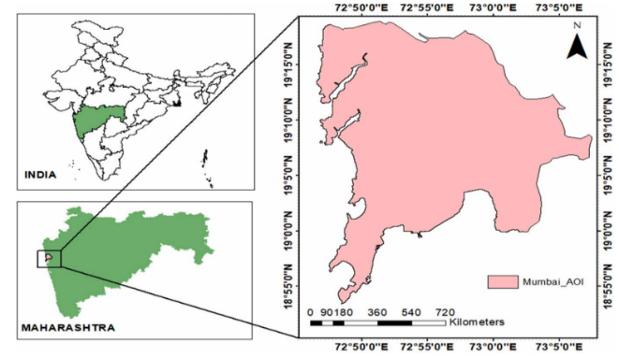
Problem Statement
Problem Identified
Mumbai faces severe flooding almost every monsoon due to heavy rainfall, coastal geography, and an outdated drainage system.
No real-time flood alert system exists to warn residents or guide quick response.
Lack of an integrated platform for evacuation routes, nearby shelters, hospitals, and essential stores worsens the crisis.
People rely on Google Maps, which does not show flooded/blocked roads or disaster-specific information.
This results in confusion, transport disruption, property damage, and loss of lives during floods.
Justification for Solution
Current flood management in Mumbai is reactive, focusing on post-disaster relief rather than prevention.
AI and Machine Learning can use rainfall, drainage, and satellite data to predict high, medium, and low-risk flood zones in real time.
GIS-based visualization can map risk-prone areas and suggest safe, dynamic evacuation routes.
An AI-integrated platform can deliver:
Real-time flood risk alerts.
Risk-aware evacuation routing.
Nearby shelters, hospitals, pharmacy, etc.
This solution would enhance public safety, support disaster response teams, and strengthen Mumbai’s urban flood resilience.

Slide 10
Objectives of the Project
To study ward-level flood susceptibility and predict flood risk categories (low, medium, high) using a Voting Ensemble model combining Random Forest and XGBoost.
To design probabilistic GIS-based flood risk maps that support decision-making for disaster management authorities.
To implement risk-aware evacuation routing using modified Dijkstra and A* algorithms, minimizing exposure to flood-prone areas.
To develop and test an automated alert dissemination system for real-time flood warnings and evacuation routes via SMS/Email notifications.

Slide 11
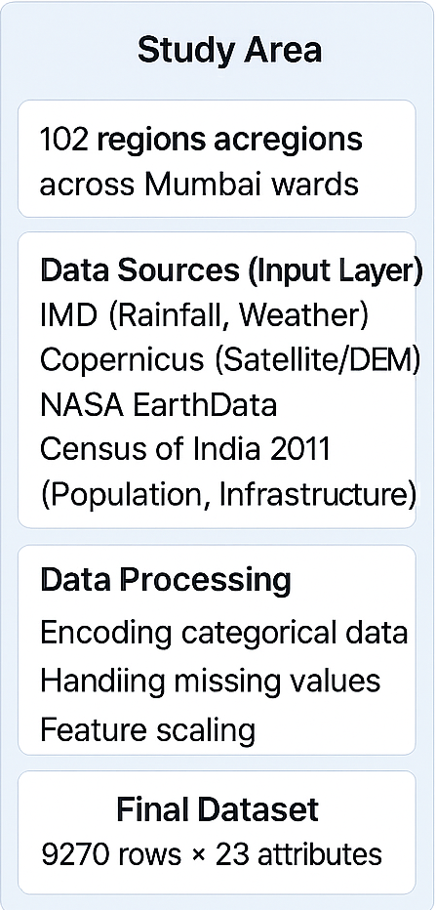
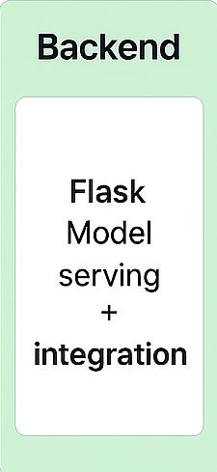
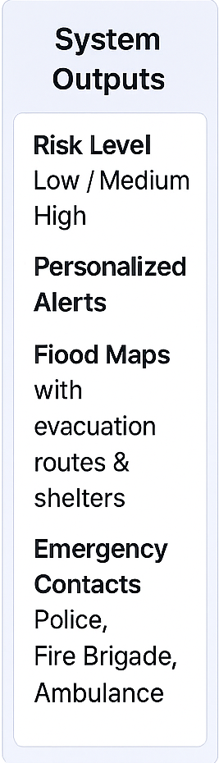
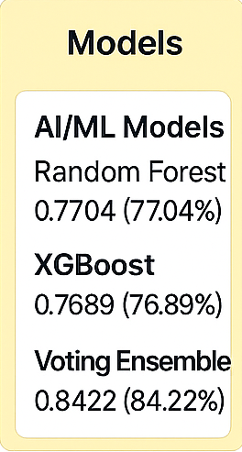
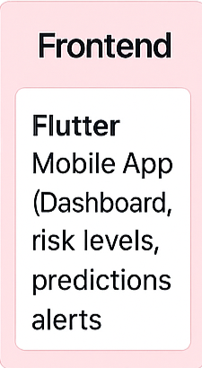
Methodology
Fig 1:- Flood Management System Overview

Slide 12
Implementation
Data Collection
Collected rainfall, hydrology, elevation, land use, and population data (IMD, ISRO, OSM, Census).Finalized 15 attributes for flood risk analysis.
Data Preprocessing
Removed irrelevant features and handled missing values. Encoded categorical features and normalized numerical ones.
Predictive Modeling
Used a Voting Ensemble (Random Forest + XGBoost) to classify risk levels (Low/Medium/High). Evaluated with Accuracy, Precision, Recall, and F1-score.
Risk Mapping
Plotted flood risk zones on ward-level maps with color codes (Green, Yellow, Red). Built an interactive GIS dashboard for real-time visualization.
Evacuation Routing
Modeled Mumbai’s road network as a weighted graph with risk-based penalties. Applied modified Dijkstra and A* algorithms for safest routes.
Alerts
Integrated Twilio API to send SMS/Email alerts with risk status.

Slide 13
Innovative Work ( if any)
Integrated Framework: Combines AI prediction, GIS mapping, evacuation routing, and real-time alerts in a single system.
Ward-Level Precision: Flood susceptibility studied at Mumbai ward level, ensuring localized and actionable risk categorization (Low/Medium/High).
Risk-Aware Routing: Enhanced Dijkstra & A* algorithms to minimize exposure to flood-prone roads during evacuation.
Automated Multi-Channel Alerts: Dissemination of real-time flood warnings via SMS/Email, unlike current systems that lack proactive alerts.

Slide 14
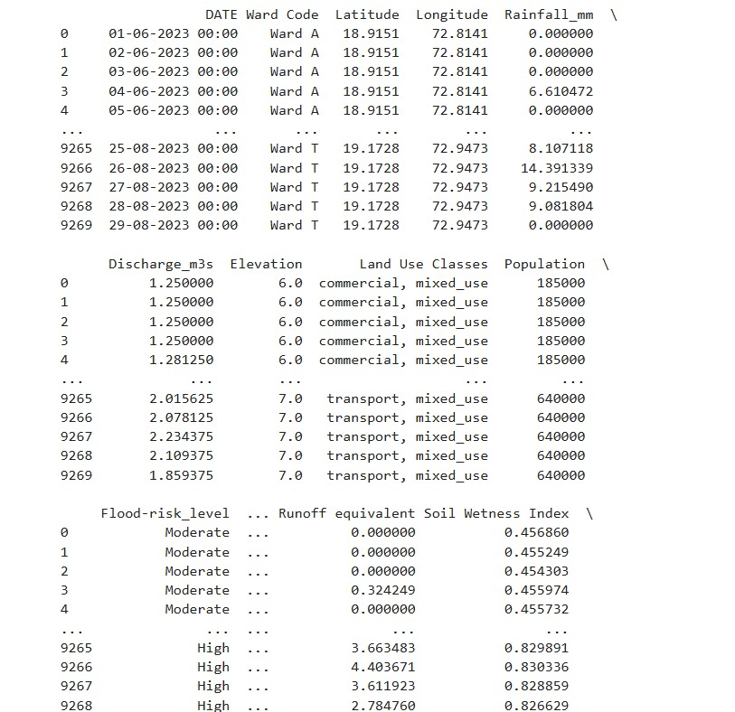
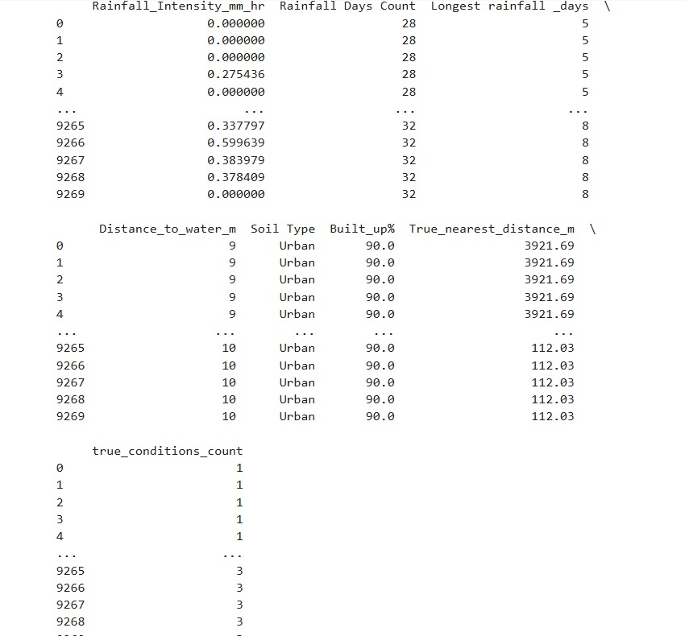
Work done

Slide 15
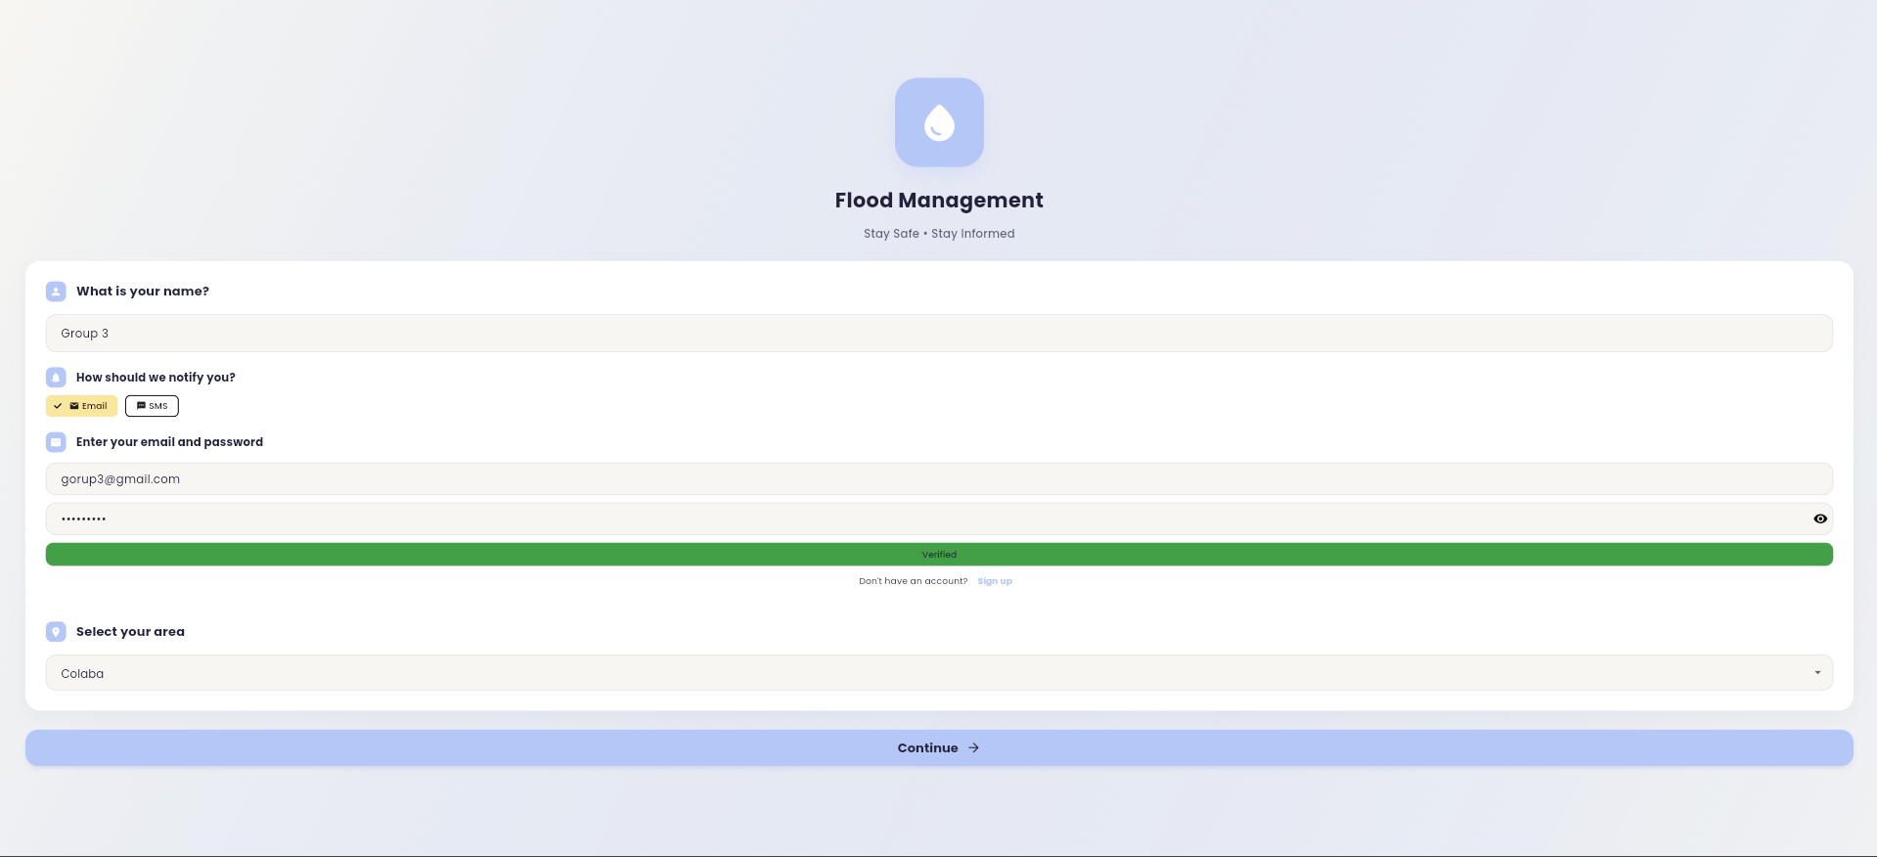
Result & Discussion
Fig 1:Login Page

Slide 16
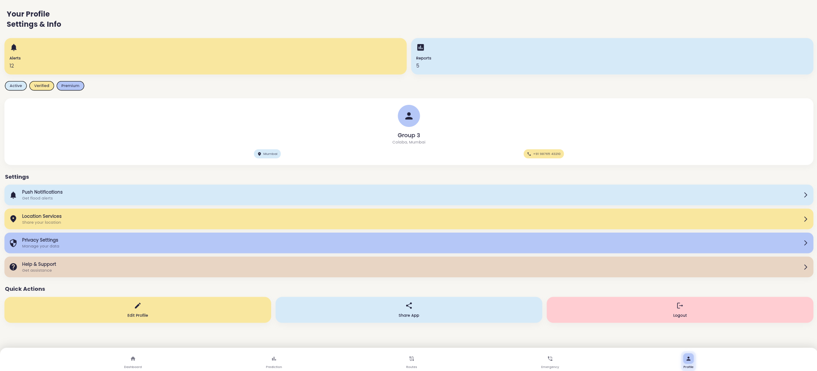
Result & Discussion
Fig 2:User Profile

Slide 17
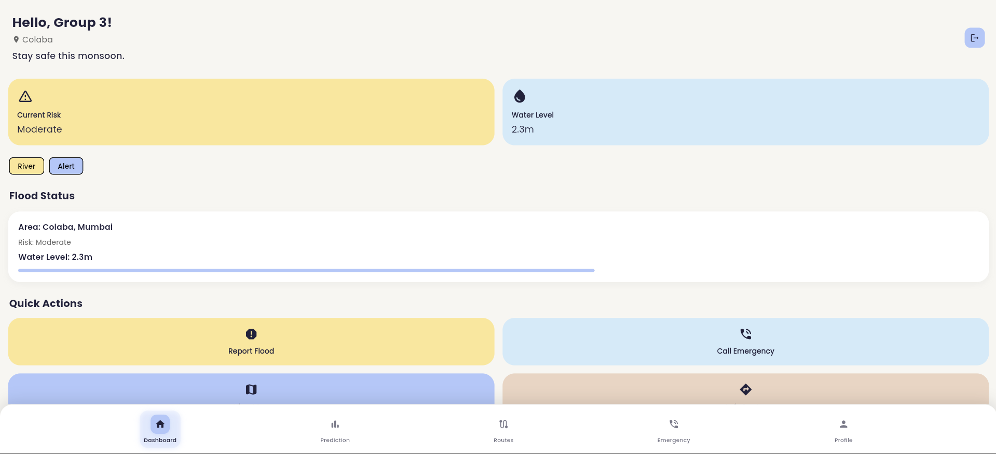
Result & Discussion
Result & Discussion of the project
Fig 3:Home Page

Slide 18
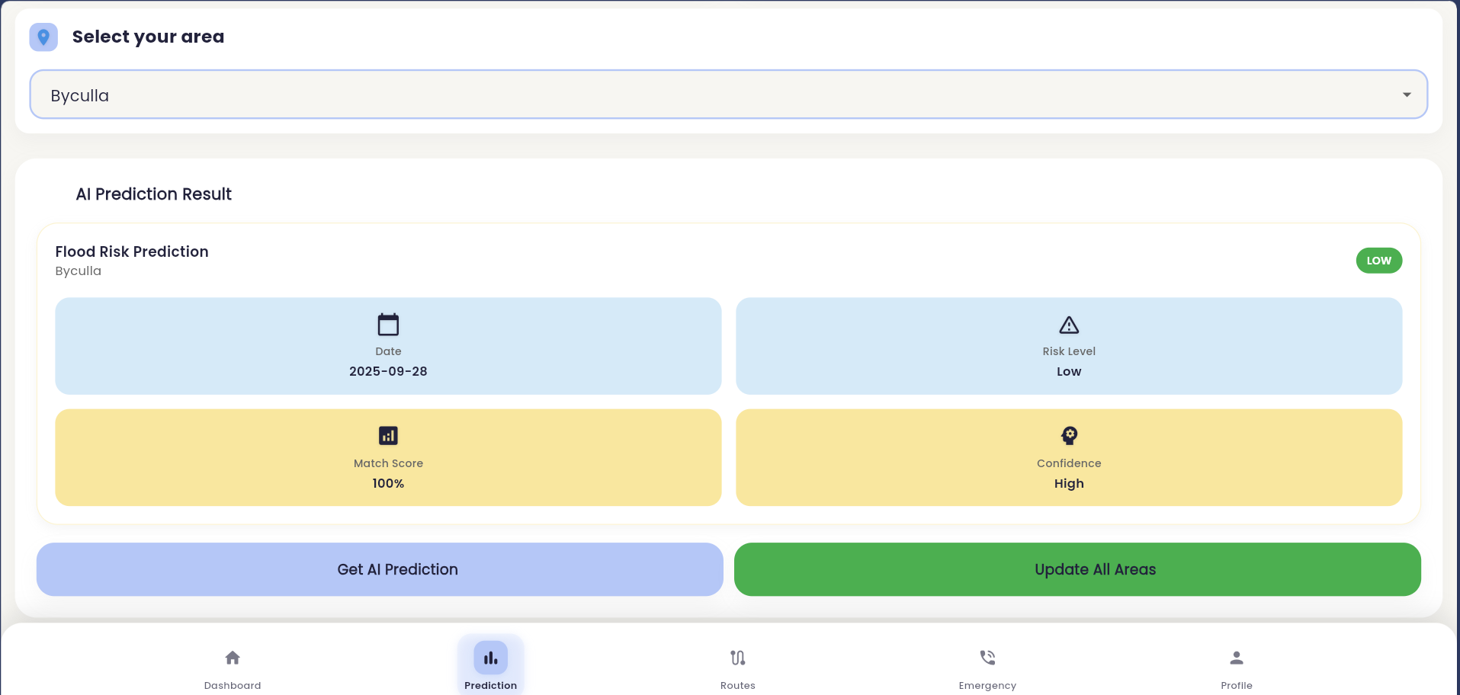
Result & Discussion
Result & Discussion of the project
Fig 4.1:Prediction

Slide 19
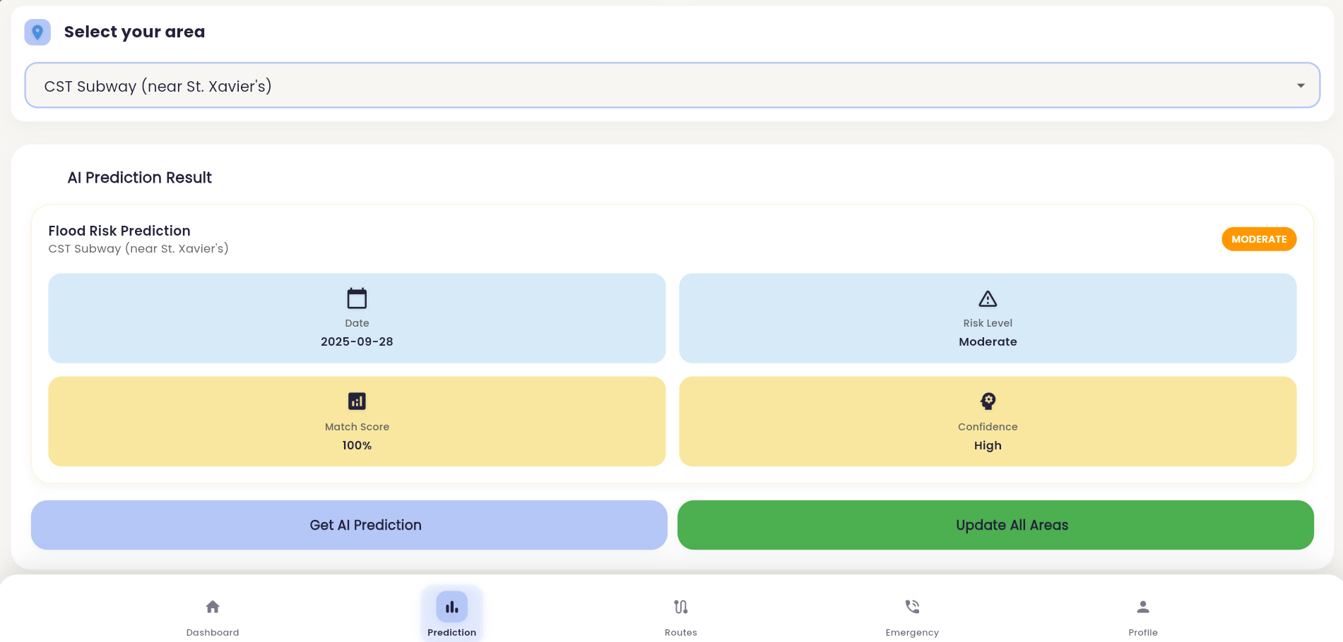
Result & Discussion
Fig 4.2:Prediction

Slide 20
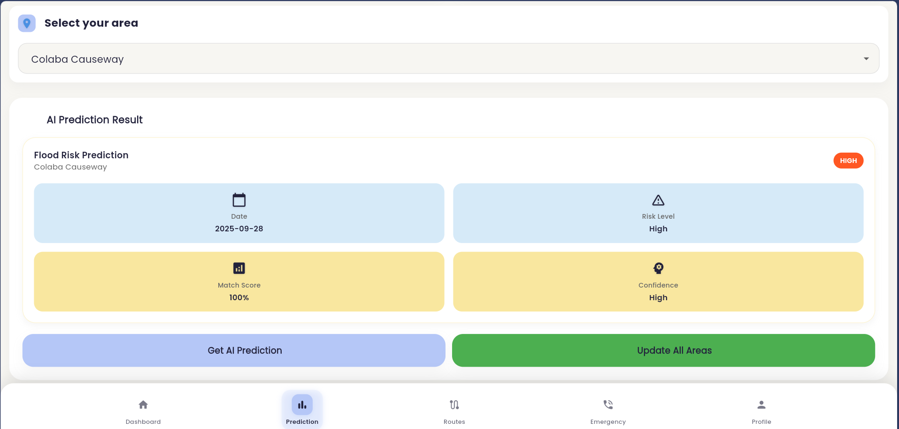
Result & Discussion
Fig 4.3:Prediction

Slide 21
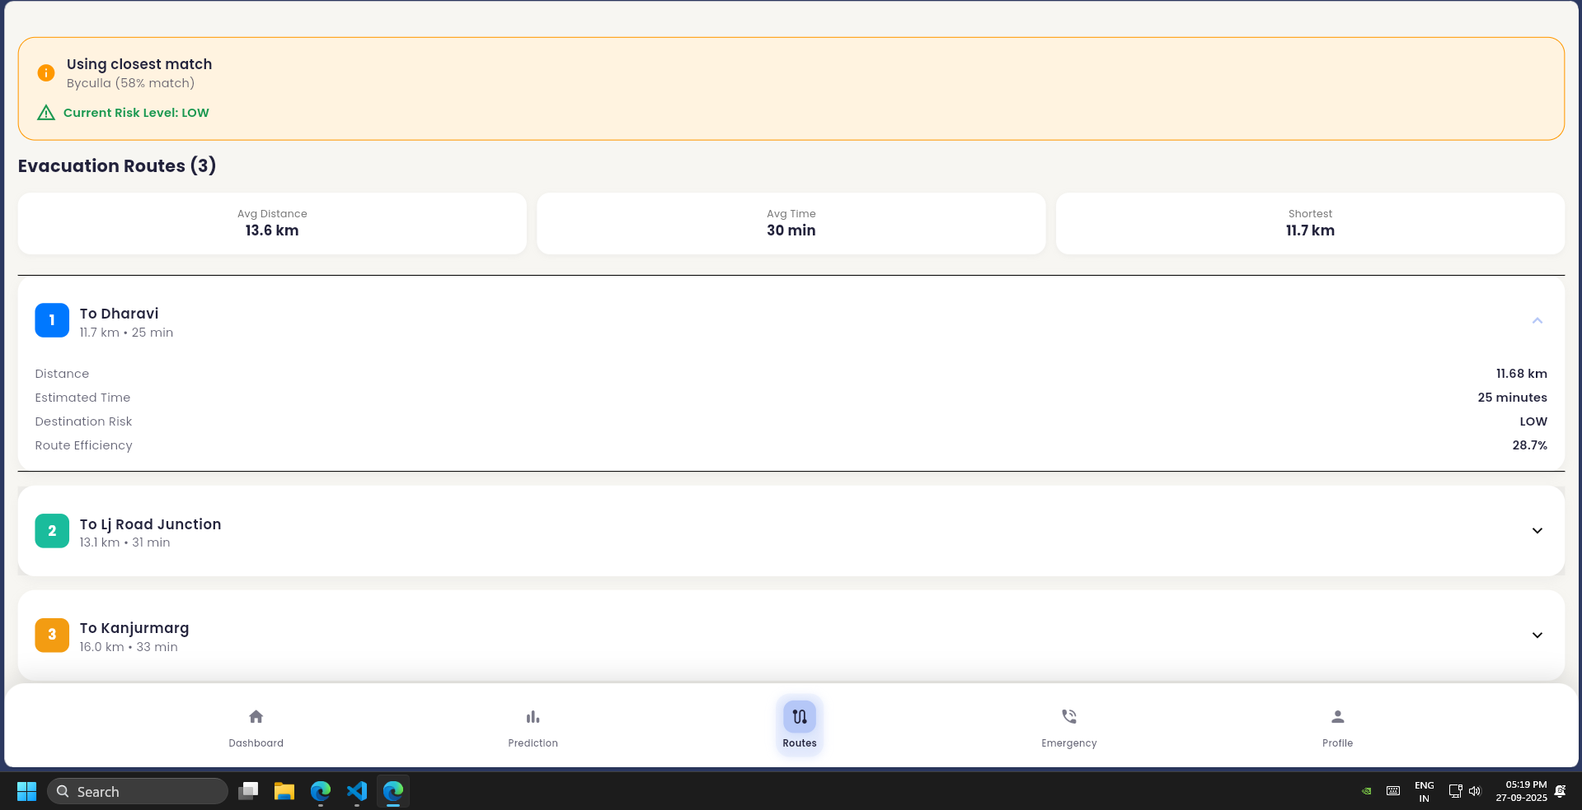
Result & Discussion
Result & Discussion of the project
Fig 5:Routes

Slide 22
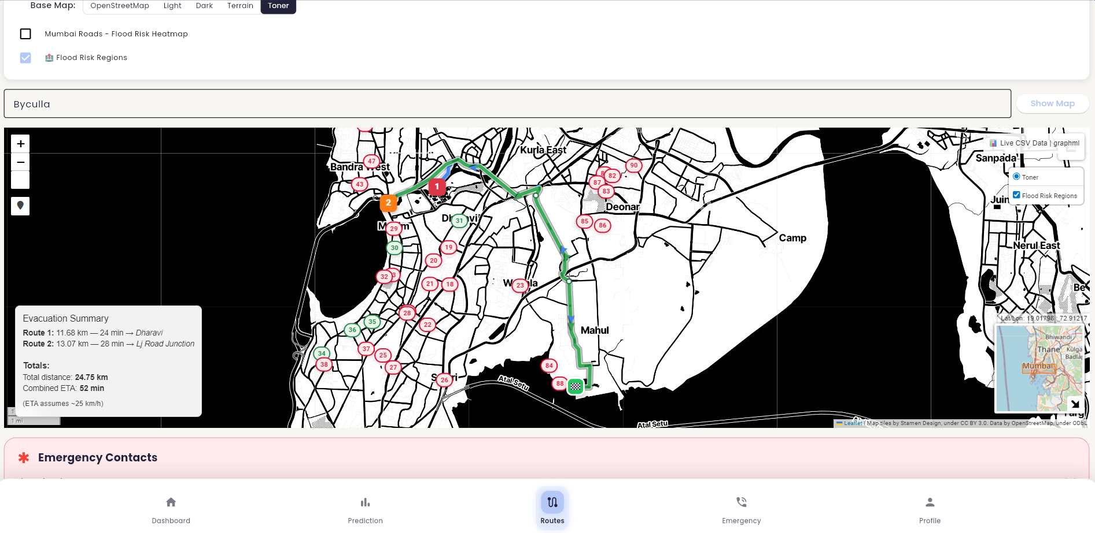
Result & Discussion
Result & Discussion of the project
Fig 6.2:Evacuation Routes

Slide 23
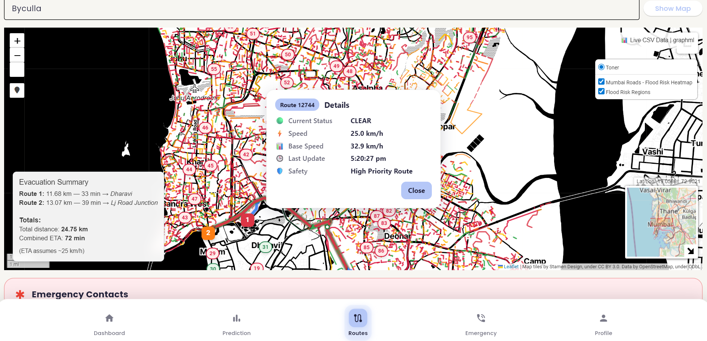
Result & Discussion
Result & Discussion of the project
Fig 6.1:Evacuation Routes

Slide 24
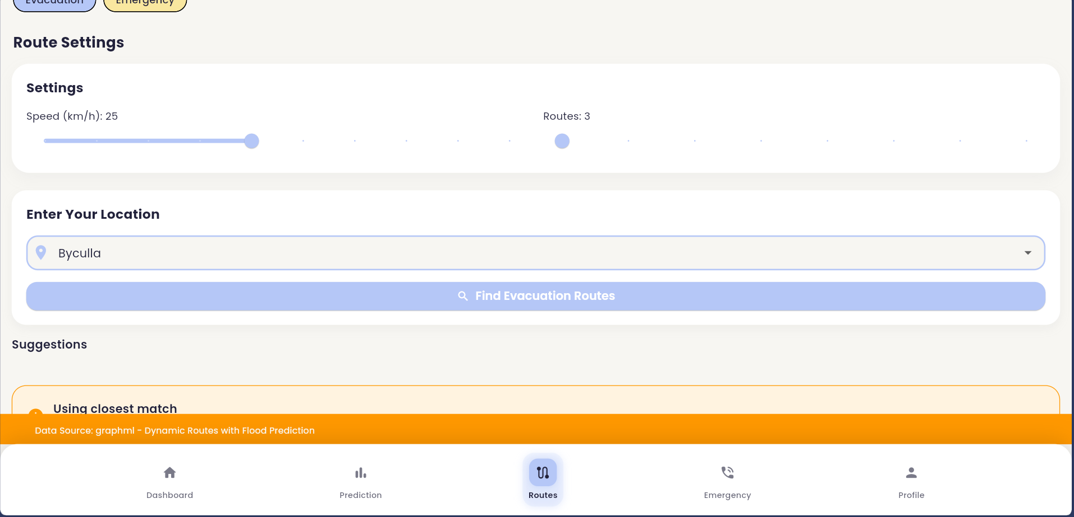
Result & Discussion
Result & Discussion of the project
Fig 6.2:Evacuation Routes

Slide 25
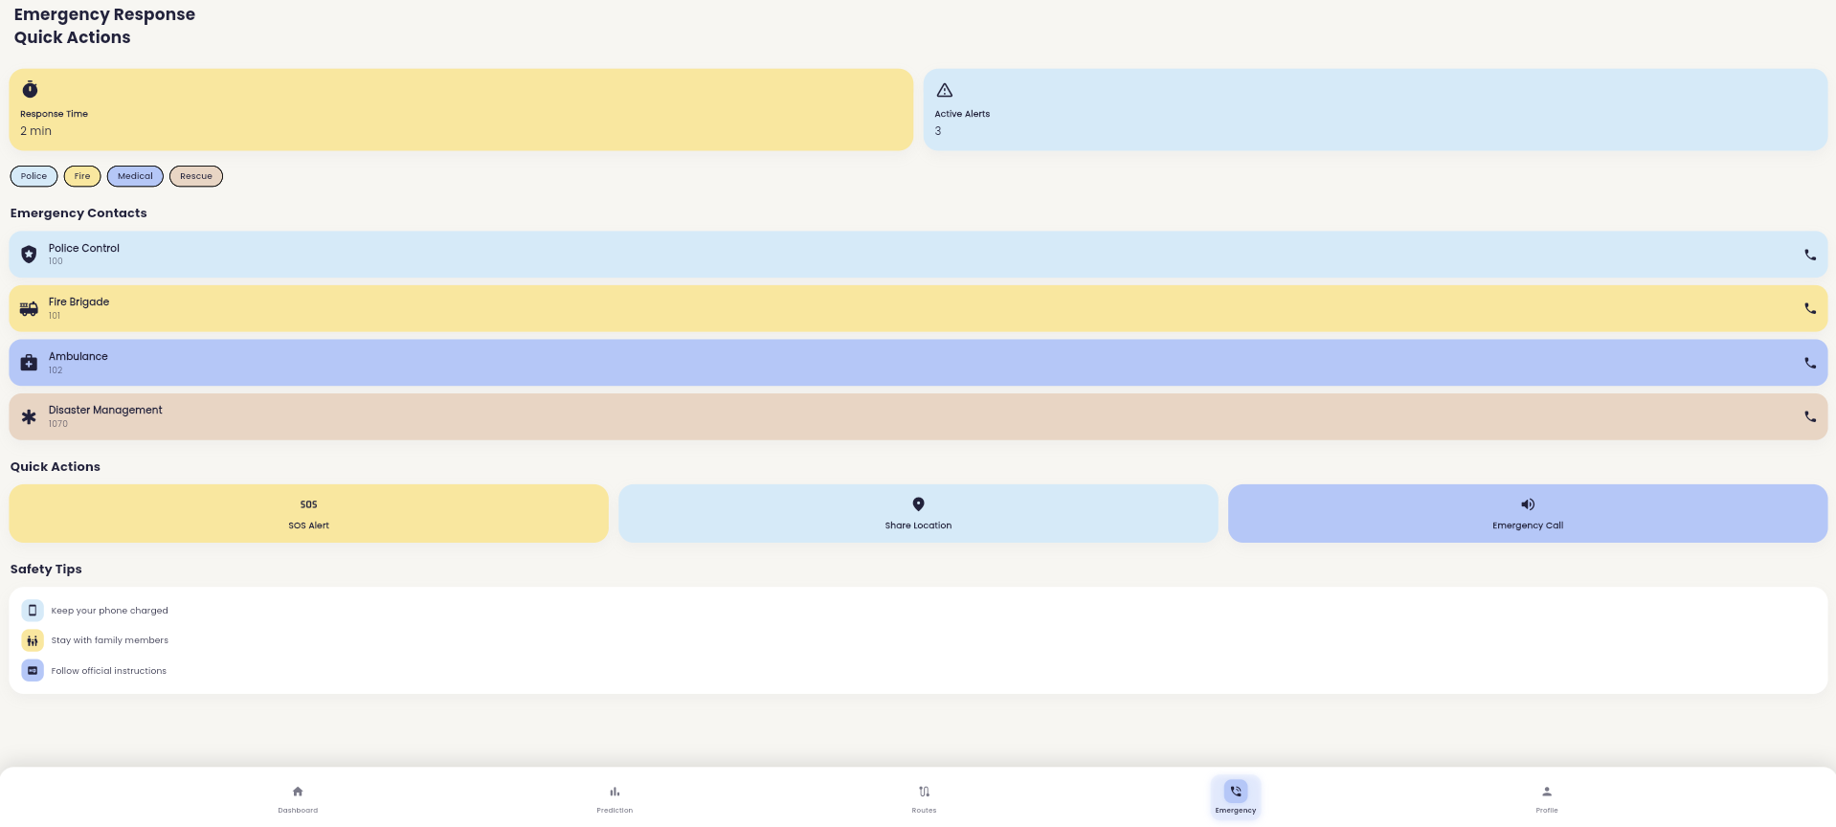
Result & Discussion
Fig 7:Emergency

Slide 26
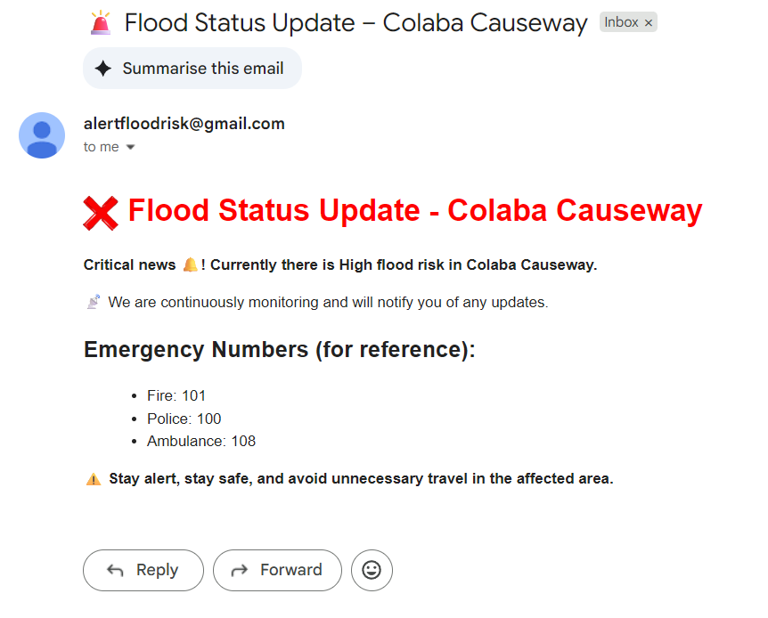
Result & Discussion
Fig 7:Alert

Slide 27
Conclusion & Future Scope
Conclusion
This research presents an integrated AI-GIS framework for flood risk prediction and evacuation in Mumbai. The ensemble model accurately identified flood-prone zones, while risk-aware routing optimized safe evacuation paths. Automated alerts and scalable deployment make the system a proactive and practical tool for urban flood resilience.
Future Scope
The system can be enhanced with IoT-based real-time water sensors and SAR data integration for higher accuracy. Collaboration with municipal authorities can enable large-scale deployment across wards. The framework is scalable to other flood-prone Indian cities, supporting nationwide disaster preparedness.

Slide 28
Publication / Presentation / Project Competition
Research Paper Submitted
Submitted to: HYDRO INTERNATIONAL 2025 30th International Conference, Nit Rourkela
Status: Under Review
Submitted to: 2nd International Conference on Pioneering Developments in Computer Science and Digital Technologies (IC²SDT 2025), NIT Delhi.
Status: Under Review
Submitted to: 4th International Conference onParadigm Shifts in Communication, Embedded Systems, Machine Learning and Signal Processing (PCEMS 2025)
Status: Under Review

Slide 29
References
List of papers/books/websites etc refer for project
Journals
Prakas, K. (2011). Feedback and optimal sensitivity: Model reference transformations, multiplicative seminorms, and approximate inverses. IEEE Transactions on Automatic Control, 26(2): 301–320.
Text books
Myers, D. G. (2007). Psychology (1st Canadian ed.). Worth: New York.
Conference proceedings
Payne, D.B. and Gunhold, H.G. (1986). Digital sundials and broadband technology, In Proc. IOOC-ECOC, 1986, pp. 557-998.
Reports
Milton, M and Robert, L. (2004). Atmospheric carbon emission through genetic algorithm, Environment and Technical Report No.3., Indian Meteorological Department., New Delhi.

Slide 30
References
List of papers/books/websites etc refer for project
Online journals with a DOI (Digital Object Identifier)
Krebs, D.L. and Denton, K. (2006). Explanatory limitations of cognitive developmental approaches to morality. Psychological Review, 113(3): 672- 675. doi: 10.1037/0033-295X.113.3.672
Online journals without a DOI
Vicki, G.T., Thomae, M., Cullen, A. and Fernandez, H. (2007). Modeling the hydrological impact on Tropical Forests. Forest Ecology, 13(10): 122-132. Retrieved from http://www.uiowa.edu/~grpproc/crisp/crisp.html
Online abstracts
Perilloux, C. and Buss, D.M. (2008). Human relationships: Costs experienced and coping strategies deployed. Evolutionary Psychology, 6(1): 164-181. Abstract retrieved from http://www.epjournal.net

Slide 31
References
List of papers/books/websites etc refer for project
Online books
Perfect, T.J. and Schwartz, B. L. (Eds.) (2002). Applied metacognition. Retrieved from http://www.questia.com/read/107598848 (--If DOI is available, use the DOI instead of a URL)
Chapters from a book
Krebs, D.L. and Denton, K. (1997). Social illusions and self deception: The evolution of biases in person perception. In J. A. Simpson & D. T. Kenrick (Eds.), Evolutionary social psychology (pp.21-48). Hillsdale, NJ: Erlbaum.
Books in print form
Snyder, C.R., Higgins, R.L. and Stucky, R.J. (Eds.). (1983). Excuses: Masquerades in search of grace. New York, NY: John Wiley & Sons.
Dissertations and Thesis
Mack, S. (2000). “Desperate Optimism” M.S. Thesis, University of Calgary, Canada.

Slide 32
Thank you !
Nagpur | Pune | Jalgaon | Amravati | Pandhurna | Bhandara

Slide 33
NOTE : Kindly Delete this slide at the end
Guidelines:
All main Head points(index points) should be written in Times new roman with font size 31.
All the Heading should be written in Times new roman with font size 18 and BOLD.
All the text in the body should be written in Times new roman with font size 16 only with black font colour.
All Figures should be illustrated with Itallic Times new roman with font size 16 only with black font colour
Work plan provided is sample , you all need to correct according to your project.
Proposed Methodology slide should include Block diagram and flow chart.
Work done slide should include detail circuit diagram(for hardware based project) and snapshot of intermediate results.
Nagpur | Pune | Jalgaon | Amravati | Pandhurna | Bhandara

